Slide 1
AMAZON SALES
DATA ANALYSIS REPORT
Tushar Deepak Kamble

Slide 2
Problem Statement
Objective
Benefits
Help out to make better business decisions.
Help analyze customer trends and satisfaction, which can lead to new and better products and services.
Gives better insight of customers base.
Helps in easy flow for managing resources.
Sales management has gained importance to meet increasing competition and the need
for improved methods of distribution to reduce cost and to increase profits. Sales
management today is the most important function in a commercial and business
enterprise.
Sales management has gained importance to meet increasing competition and the
need for improved methods of distribution to reduce cost and to increase profits. Sales
management today is the most important function in a commercial and business
enterprise.

Slide 3
Quick Insight
﻿
488.56K
Total revenue
74
Countries
130.7M
Total Quantity
10
Total Item type
439
Customers

Slide 4
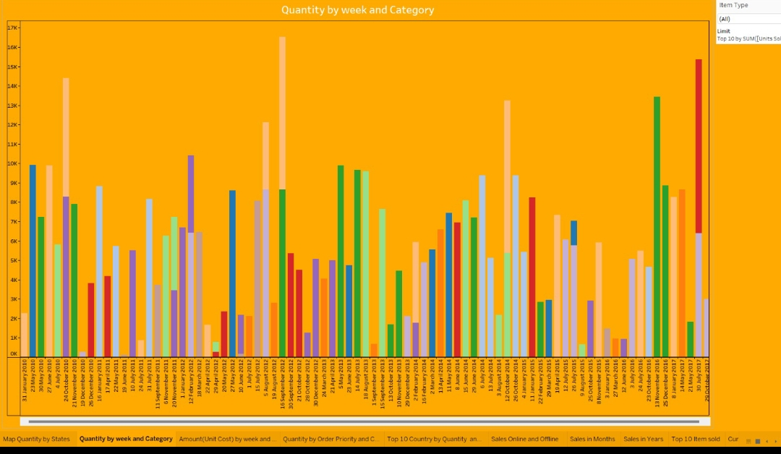
Quantity by week and Category
﻿

Slide 5
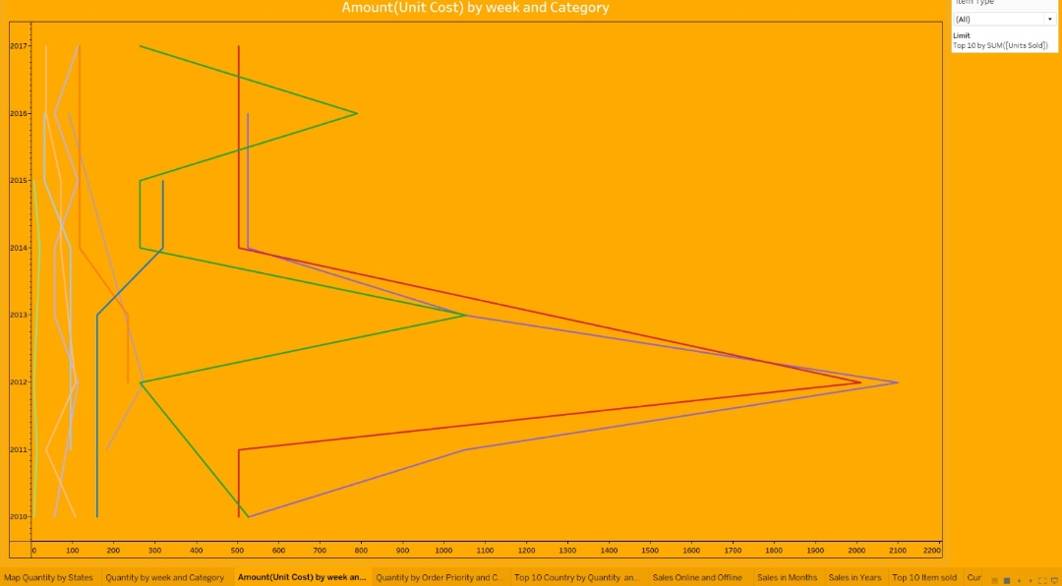
Unit Cost by week and Category

Slide 6
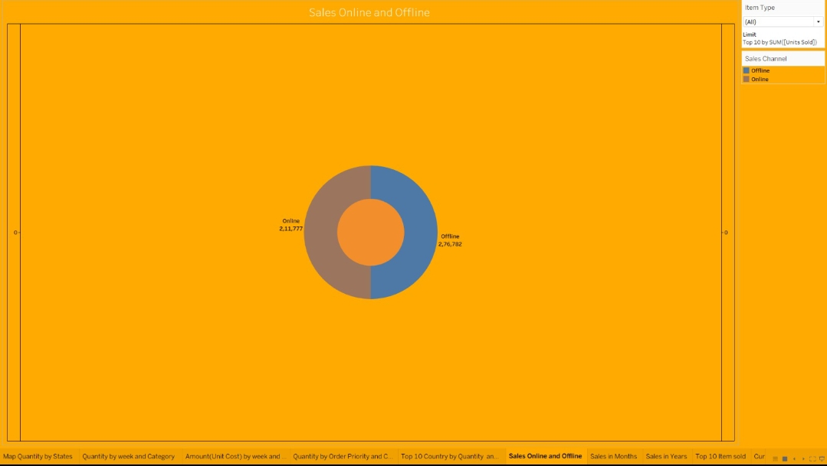
Sales Online and Offline

Slide 7
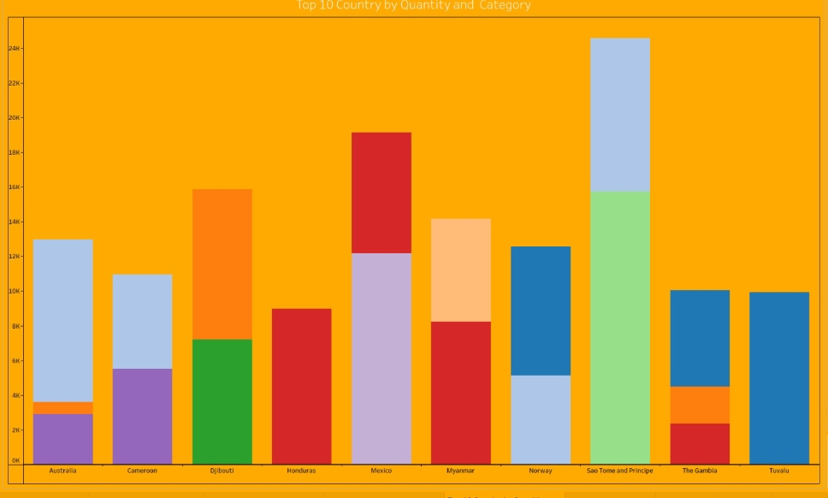
Top 10 Country by Quantity and Category

Slide 8
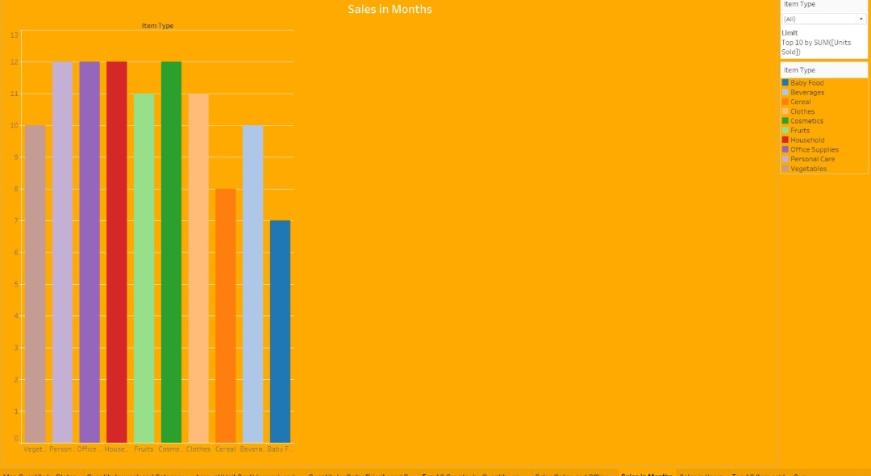
Sales in month

Slide 9
Conclusion
1.The region with the highest total revenue from sales is Europe with $11,584,502.59, generated from selling Office Supplies to Russia offline in May 2014.
2.The product category generating the highest total revenue overall is Office Supplies at $39,296,425.02 from sales to Rwanda offline in February 2013.
3.Sub-Saharan Africa has generated strong sales revenue across multiple product categories like Household, Baby Food, Vegetables, etc. showing it to be an important market.
4.Online sales channels tend to have higher profit margins compared to offline sales. For example, online sales of Clothes to Cote d'Ivoire in June 2012 had a profit margin of over 70% compared to around 35-40% for offline sales.
5.Higher priority orders (High and Critical priority) generate more revenue compared to lower priority orders, indicating customer willingness to pay premium for urgent delivery.
6.Longer delivery lead times (difference between Order Date and Ship Date) are seen for offline orders compared to online orders on average.

